Slide 1

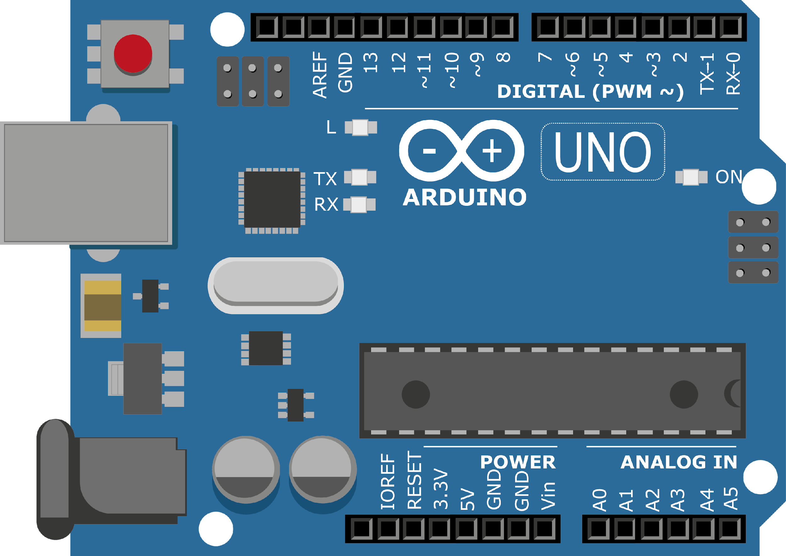
ARDUINO MASTER CLASS
26
Power Monitoring system

Slide 2
26 AGENDA
02
03
01
Power Monitoring system
Circuit Design
Interview questions & News

Slide 3
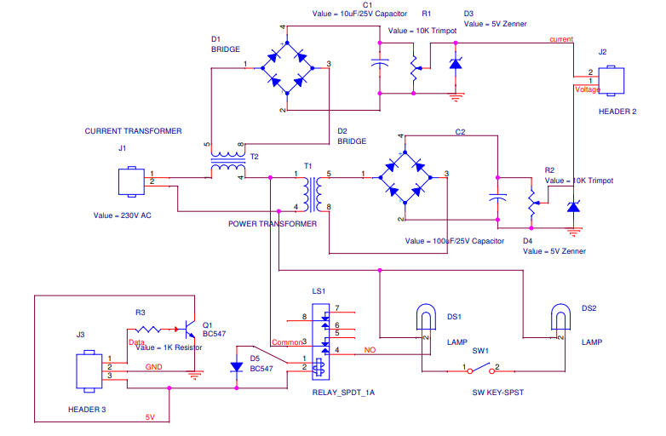
Circuit Design

Slide 4

INTERVIEW QUESTIONS
Unilateral & Bilateral Circuit
Zener diode
Ideal Transformer
Unilateral Network - A circuit whose operation, the behavior is dependant on the direction of the current through various elements
Bilateral Network: A circuit whose characteristics, behavior are the same irrespective of the direction of current through various elements
An ideal transformer is an imaginary transformer in which no losses occur at all. In other words, the transformer Input power is equal to the output power of the transformer i.e. they have 100% efficiency. It is just a theoretical transformer because there must be some losses in a real transformer.
A Zener diode is a special type of diode designed to reliably allow current to flow "backwards" when a certain set reverse voltage, known as the Zener voltage, is reached. Zener diodes are manufactured with a great variety of Zener voltages and some are even variable.

Slide 5

THANKS!

